Slide 1
Team IC 22019
By: Sanaa Mironov, Anshika Patel, and Jagan Velraj

Slide 2
What is problem/happening
UMD Department of Transportation Services (DOTS) has a situation where increase in usage of the e-scooters might be a concern for campus sidewalks in the future.
They have data and know these infractions are happening but couldn’t assemble the data in useful format that provide useful information to enforce certain rules to improve the campus sidewalks student security.
With the data provided by the DOTs, we decided to dive deep and provide an practical solutions with our findings.

Slide 3
What question we ask
When analyzing the data provided to us, we asked:
What’s the strategic importance of identifying and targeting only the sidewalks with the most frequent infractions?
Are there any data on pedestrian traffic and when this pedestrian traffic occurs?
In what ways we can identify the scooter usage will be high?

Slide 4
Data Set
Dataset A: Data set from the month of September and November of Veo e-scooters operating on campus and parking area. The data was anonymized in geojson format.
Dataset B: GIS map data denoting the location of all sidewalks on UMD College Park campus

Slide 5
Data Set limitations
Small Data Sample
Showed only the month of September and November
No metadata like day of the week and time of the daytime
During the pandemic where online courses were widely available.
Data set during high peak like homecoming and football season.
With so much limitation on data, this could skew tangible and insightful results.

Slide 6
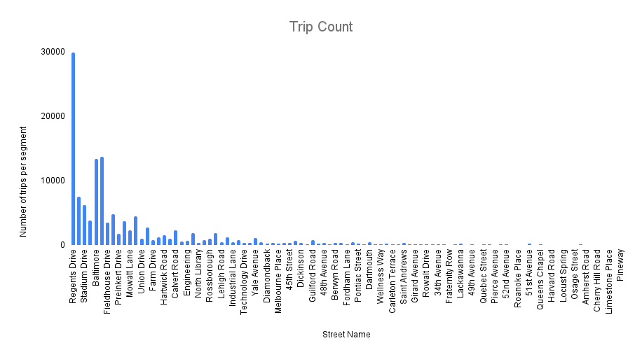
Aggregated Data - Trip Count Per Segment

Slide 7
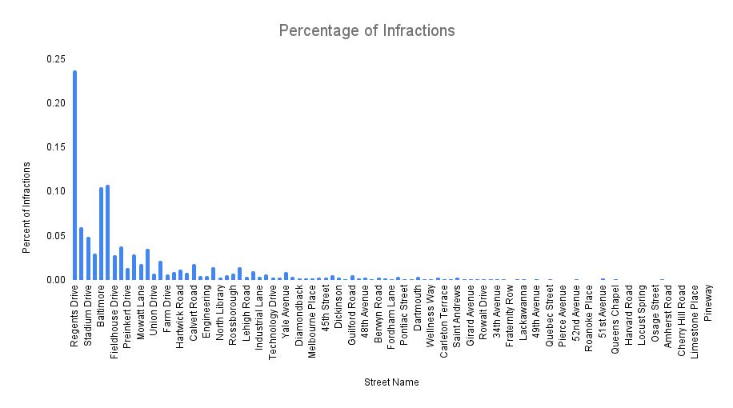
Aggregated Data Average Percent of Infractions

Slide 8
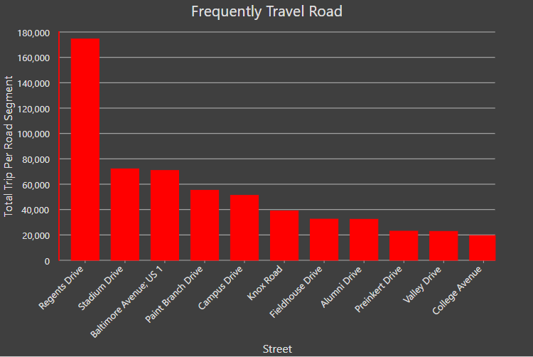
Aggregated Data - Trip Count Per Segment

Slide 9
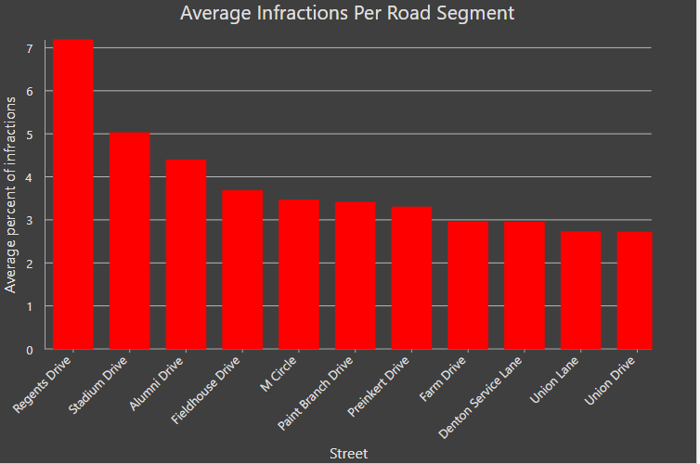
Aggregated Data - Average Percent of Infraction

Slide 10
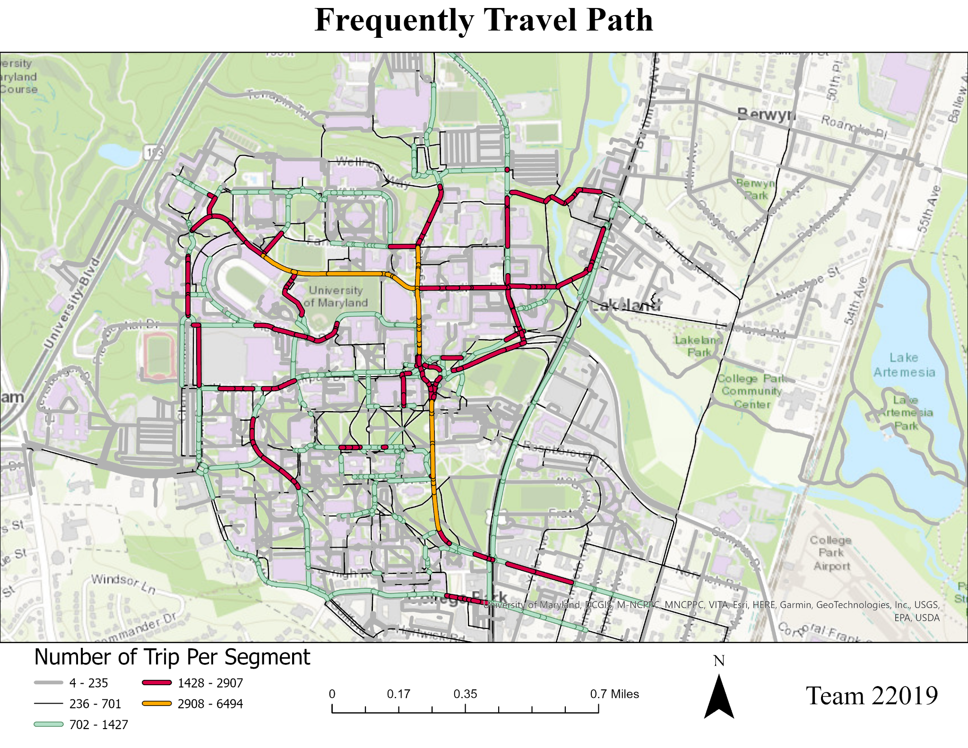
Finding
Most Travel Path: Regents Drive, Stadium Drive, Baltimore Avenue
Why:
Regents and Stadium Drive host cluster of stem (Biology, Chemistry, Engineering, etc.) buildings and lecture halls (Symons, A. James Clark, Martin, etc.)
Stadium Drive is home to the stadium and football practice complex
Baltimore Avenue is on US 1 i.e, major road
Notes:
Regents and Stadium Drive host cluster of stem (Biology, Chemistry, Engineering, etc.) buildings and lecture halls (Symons, A. James Clark, Martin, etc.), so high possibility that riders have classes there and need to travel there often. It is also football season and Stadium Drive also has the stadium and football complex for game and practice. Also Baltimore Avenue is on US Route 1 which is the main road and connect one part of campus to another, so rider are also likely to travel there offen.

Slide 11
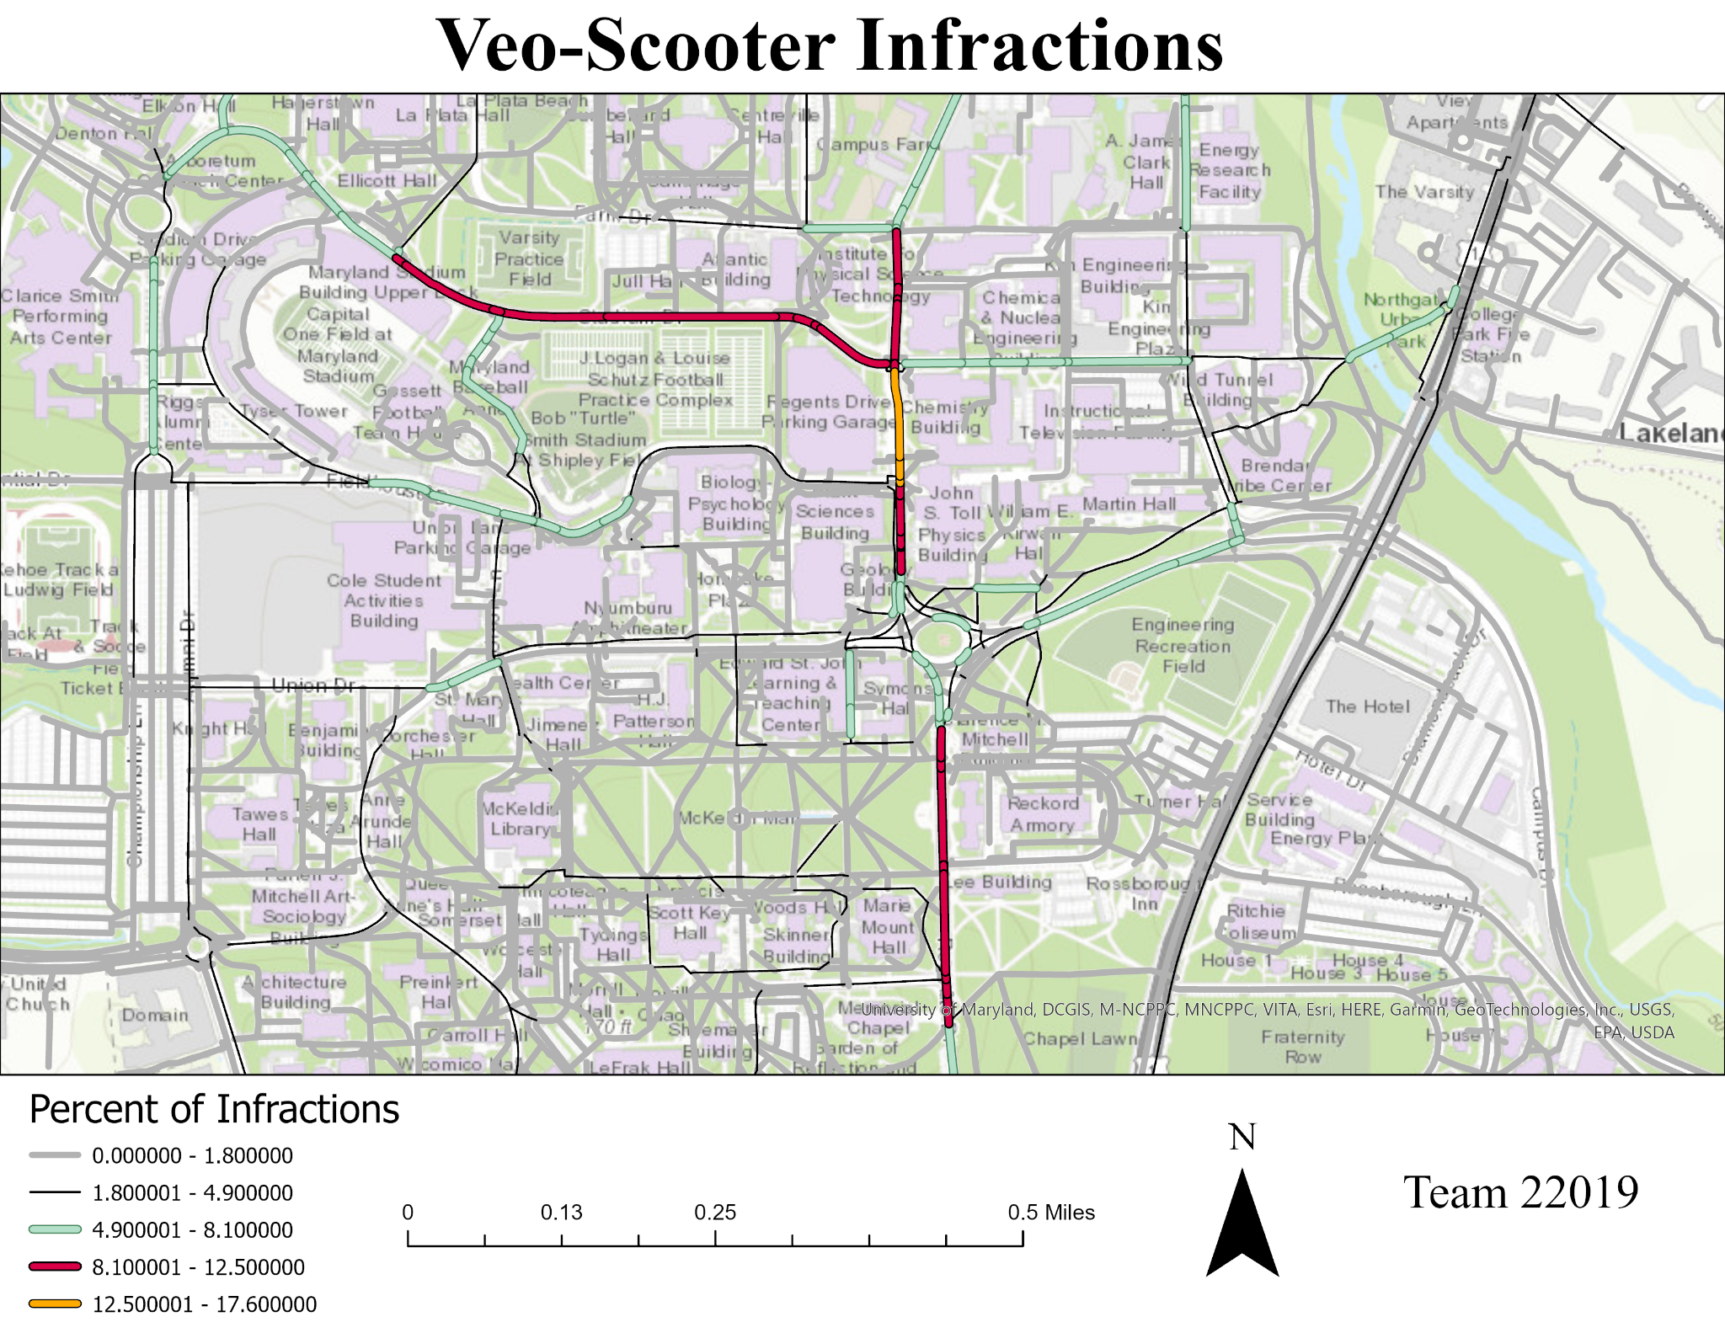
Finding
Most Infractions: Regents Drive, Stadium Drive, Alumni Drive
Why:
Heavy pedestrian traffic
Higher chances for collisions with cars near garages
Notes:
Regents and Stadium Drive host cluster of stem (Biology, Chemistry, Engineering, etc.) buildings and lecture halls (Symons, A. James Clark, Martin, etc.), so high possibility that riders have classes there and need to travel there often. It is also football season and Stadium Drive also has the stadium and football complex for game and practice. Also Baltimore Avenue is on US Route 1 which is the main road and connect one part of campus to another, so rider are also likely to travel there offen.

Slide 12
Our Recommendation
Dedicated lane for E-scooters
Focus on target geofencing
Notes:
Fractions are happening the most on roads that are narrow from this we recommend adding a dedicated lane for E-scooters and bikes.
Focus on specific location throughout the campus and to do this you need data.

Slide 13
Future Recommendations
Knowledge is power
Data collection on courses offered during a semester.
Data collection of ticket sale for big events on campus
Data collection on pedestrian.
Data collection on commuters.
Notes:
Collect data through out campus to be able to create a safer environment for students.
Some data to
Data collection on courses offered during a semester. Like location, start and stop time, day of the week, and capacity of the course.
Data collection of ticket sale for big events on campus, ie homecoming, sporting event.
Data collection on pedestrian. Where are people walking most frequently around the campus.
Data collection of the day and time of commuters. Showing the influx of students coming and leaving campus.

